Slide 2
solve problems based on time and amount computation.

Slide 3
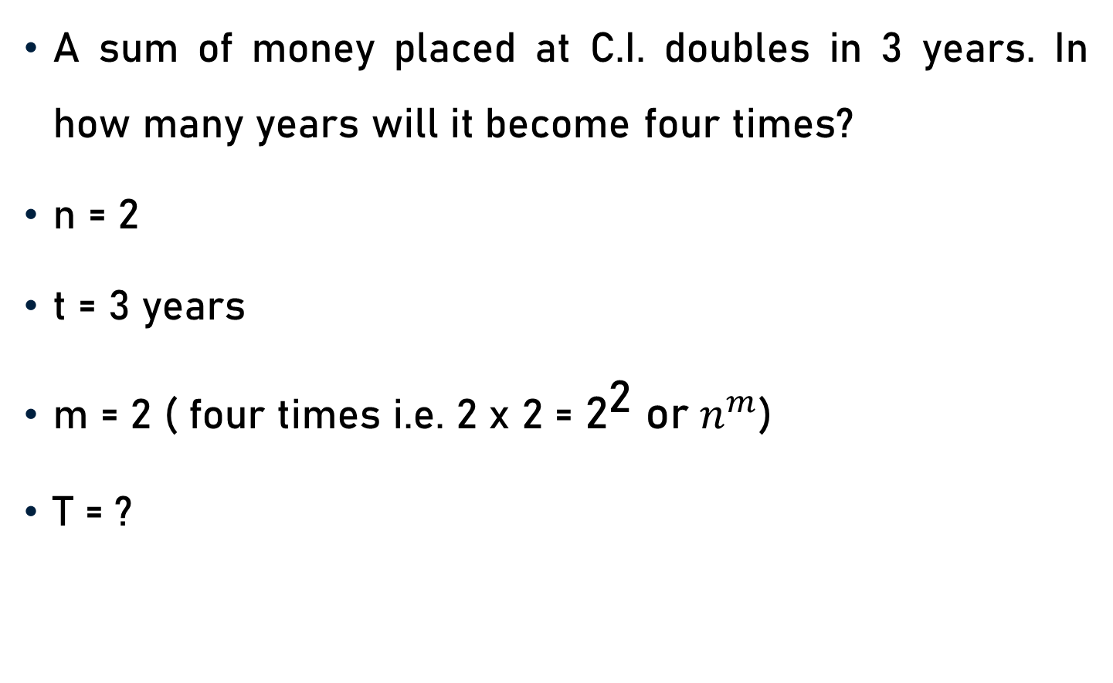
Problem 1
A sum of money placed at C.I. doubles in 3 years. In how many years will it become four times?
n = 2
t = 3 years
m = 2 ( four times i.e. 2 x 2 = ${\text{2}}^{\text{2}}$ ${\text{or} n}^{m}$)
T = ?

Slide 4
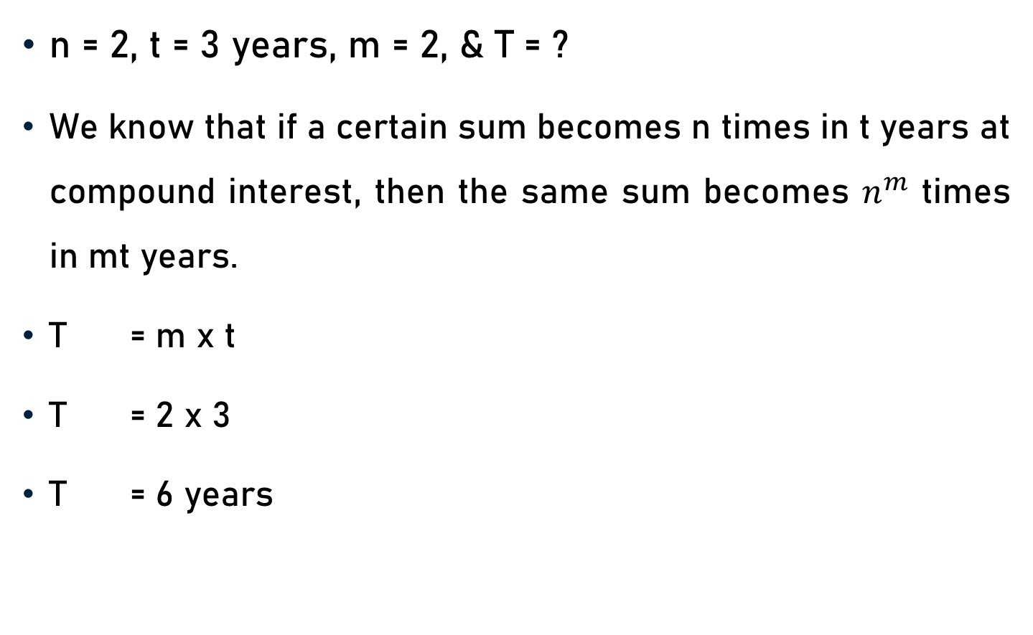
Problem 1
n = 2, t = 3 years, m = 2, & T = ?
We know that if a certain sum becomes n times in t years at compound interest, then the same sum becomes $n^{m}$ times in mt years.
T = m x t
T = 2 x 3
T = 6 years

Slide 5

Problem 2
A sum of money doubles itself at C.I. in 15 years. In how many years will it become eight times?
n = 2
t = 15 years
m = 3 ( Eight times i.e. 2 x 2 x 2 = ${\text{2}}^{\text{3}}$ or $n^{m}$)
T = ?

Slide 6

Problem 2
n = 2, t = 15 years, m = 3, & T = ?
We know that if a certain sum becomes n times in t years at compound interest, then the same sum becomes $n^{m}$ times in mt years.
T = m x t
T = 3 x 15
T = 45 years

Slide 7
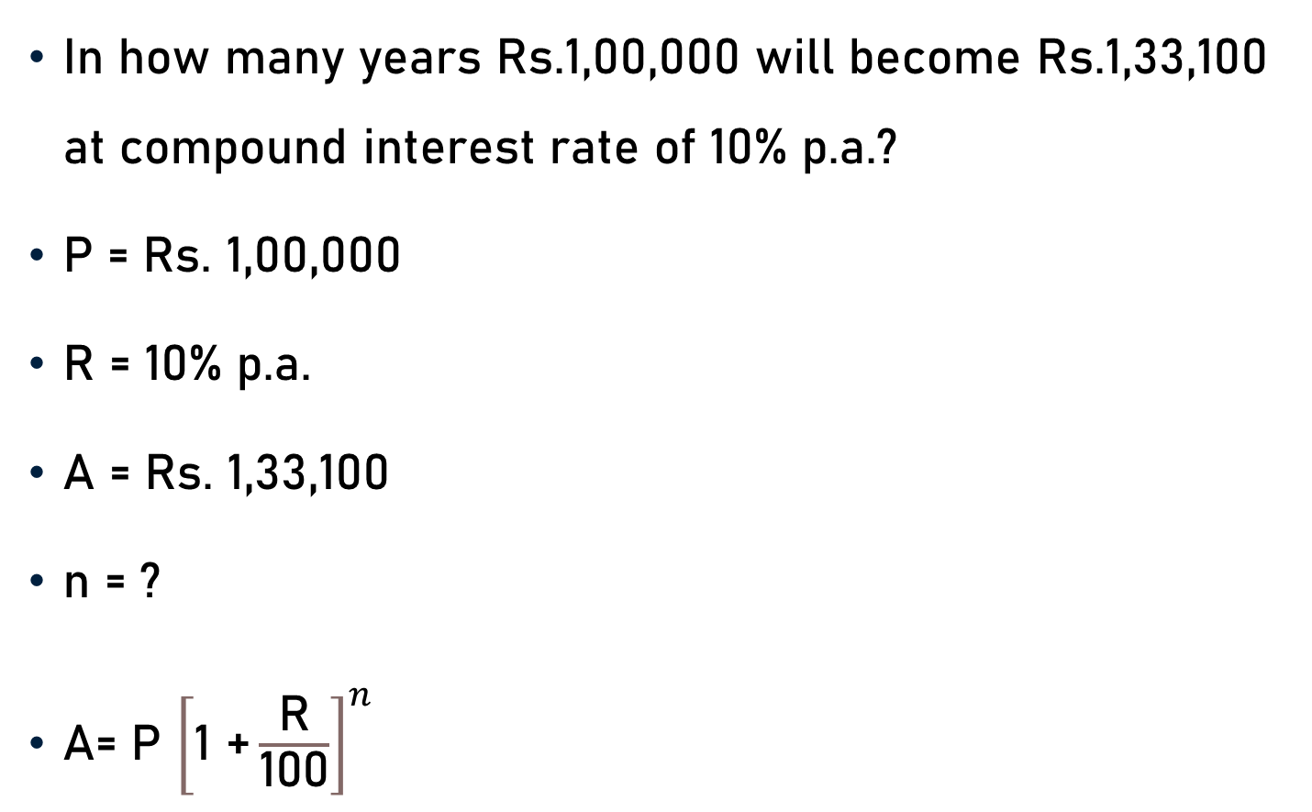
Problem 3
In how many years Rs.1,00,000 will become Rs.1,33,100 at compound interest rate of 10% p.a.?
P = Rs. 1,00,000
R = 10% p.a.
A = Rs. 1,33,100
n = ?
A= P ${\left[\text{1 +}\frac{\text{R}}{\text{100}}\right]}^{n}$

Slide 8
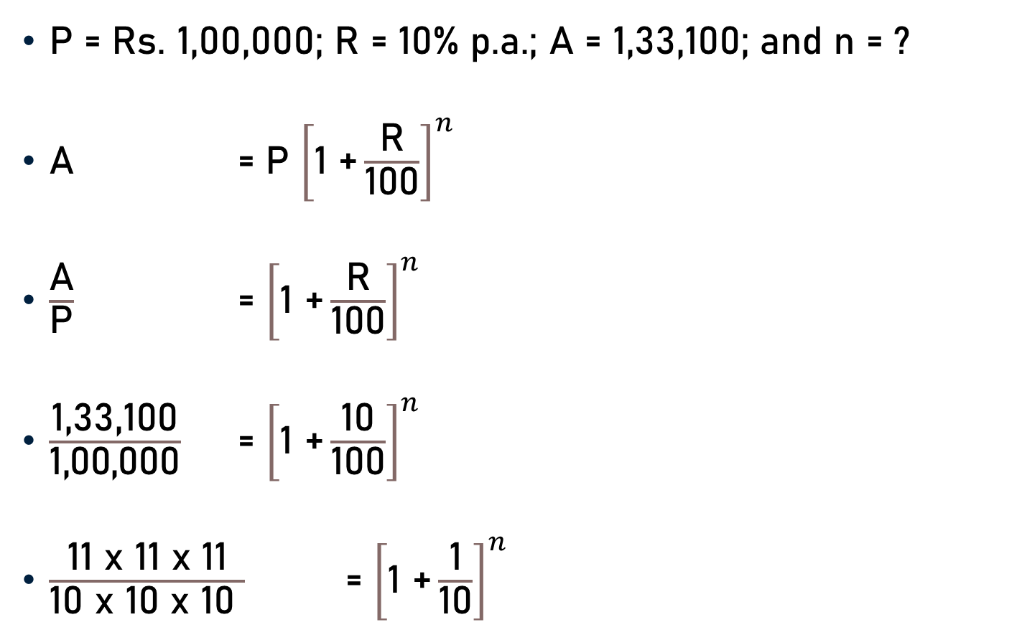
Problem 3
P = Rs. 1,00,000; R = 10% p.a.; A = 1,33,100; and n = ?
A = P ${\left[\text{1 +}\frac{\text{R}}{\text{100}}\right]}^{n}$
$\frac{\text{A}}{\text{P}}$ = ${\left[\text{1 +}\frac{\text{R}}{\text{100}}\right]}^{n}$
$\frac{\text{1,33,100}}{\text{1,00,000}}$ = ${\left[\text{1 +}\frac{\text{10}}{\text{100}}\right]}^{n}$
$\frac{\text{11 }\text{x}\text{ 11 }\text{x}\text{ 11}}{\text{1}\text{0} \text{x}\text{ 10 }\text{x}\text{ 10 }}$ = ${\left[\text{1 +}\frac{\text{1}}{\text{10}}\right]}^{n}$
1331
1000
10

Slide 9

Problem 3
$\frac{\text{11 }\text{x}\text{ 11}\text{x}\text{ 11}}{\text{1}\text{0} \text{x}\text{ 10 }\text{x}\text{ 10 }}$ = ${\left[\text{1 +}\frac{\text{1}}{\text{10}}\right]}^{n}$
${\left[\frac{\text{11}}{\text{10}}\right]}^{3}$ = ${\left[\frac{\text{1}\text{0}\text{ +} \text{1}}{\text{10}}\right]}^{n}$
${\left[\frac{\text{11}}{\text{10}}\right]}^{3}$ = ${\left[\frac{\text{11}}{\text{10}}\right]}^{n}$
3 = n
n = 3 years

Slide 10
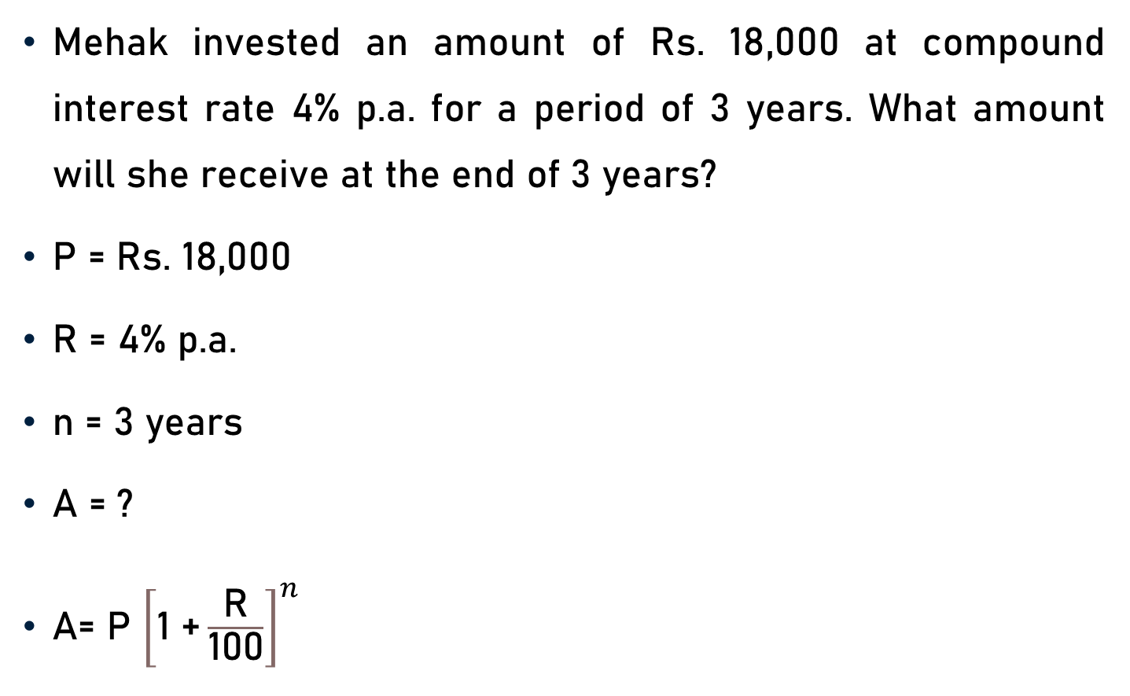
Problem 4
Mehak invested an amount of Rs. 18,000 at compound interest rate 4% p.a. for a period of 3 years. What amount will she receive at the end of 3 years?
P = Rs. 18,000
R = 4% p.a.
n = 3 years
A = ?
A= P ${\left[\text{1 +}\frac{\text{R}}{\text{100}}\right]}^{n}$

Slide 11

Problem 4
P = Rs. 18000, R = 4% p.a., n = 3 years, and A = ?
A = P ${\left[\text{1 +}\frac{\text{R}}{\text{100}}\right]}^{n}$
A = 18000 x ${\left[\text{1 +}\frac{\text{4}}{\text{100}}\right]}^{3}$
A = 18000 x ${\left[\frac{\text{100}\text{ + }\text{4}}{\text{100}}\right]}^{3}$

Slide 12
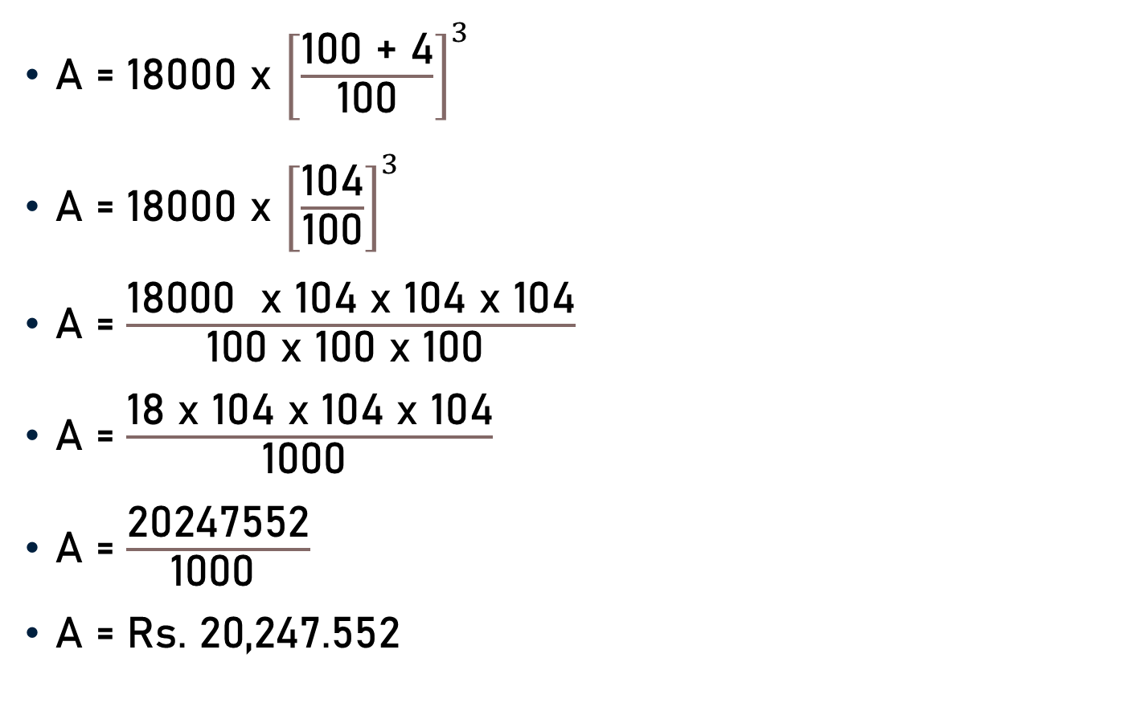
Problem 4
A = 18000 x ${\left[\frac{\text{100}\text{ + }\text{4}}{\text{100}}\right]}^{3}$
A = 18000 x ${\left[\frac{\text{104}}{\text{100}}\right]}^{3}$
A = $\frac{\text{18000} \text{x}\text{ 104 }\text{x}\text{ 104 }\text{x}\text{ 104}}{\text{100} \text{x}\text{ 100 }\text{x}\text{ 100 }}$
A = $\frac{\text{18 }\text{x}\text{ 104 }\text{x}\text{ 104 }\text{x}\text{ 104}}{\text{100}\text{0} }$
A = $\frac{\text{20247552}}{\text{100}\text{0} }$
A = Rs. $\text{20}\text{,}\text{247}\text{.}\text{552}$

Slide 13
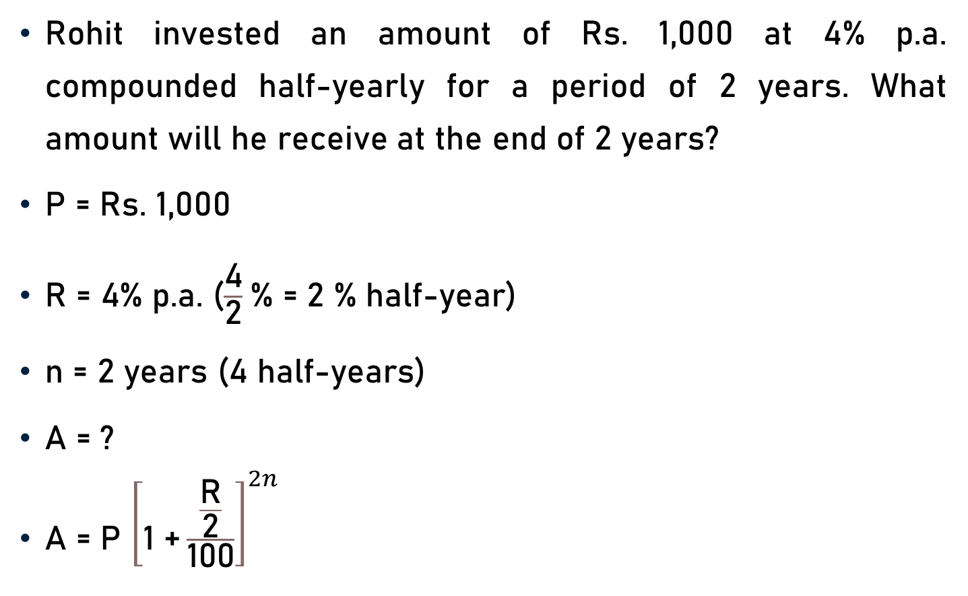
Problem 5
Rohit invested an amount of Rs. 1,000 at 4% p.a. compounded half-yearly for a period of 2 years. What amount will he receive at the end of 2 years?
P = Rs. 1,000
R = 4% p.a. ($\frac{\text{4}}{\text{2}}$% = 2 % half-year)
n = 2 years (4 half-years)
A = ?
A = P ${\left[\text{1 +}\frac{\frac{\text{R}}{\text{2}}}{\text{100}}\right]}^{2n}$

Slide 14
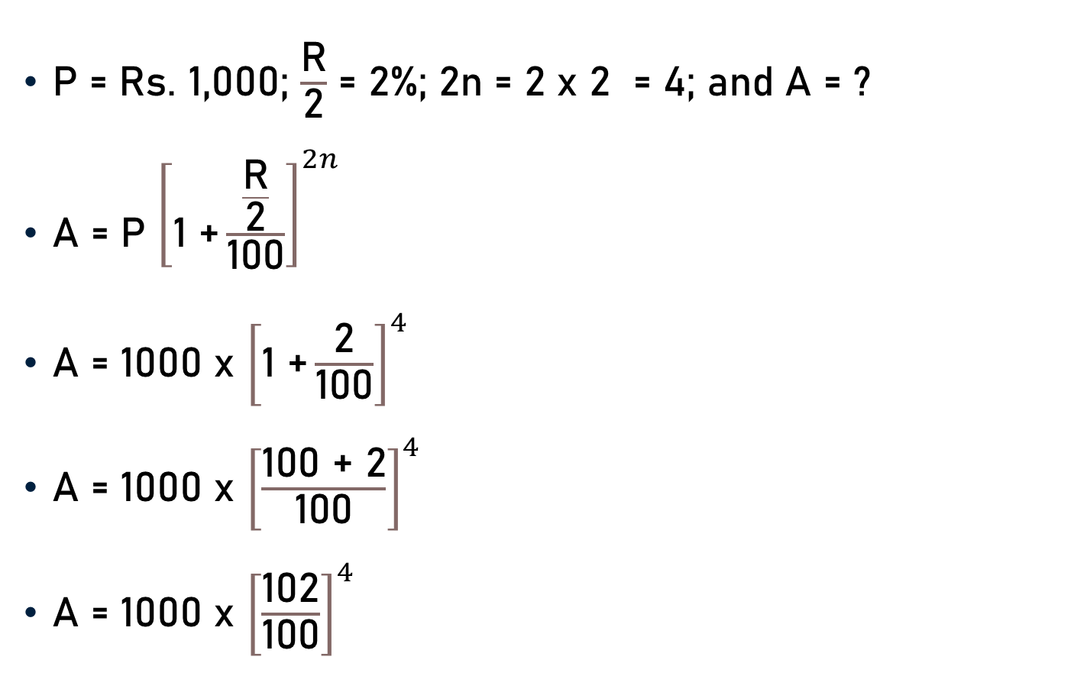
Problem 5
P = Rs. 1,000; $\frac{\text{R}}{\text{2}}$ = 2%; 2n = 2 x 2 = 4; and A = ?
A = P ${\left[\text{1 +}\frac{\frac{\text{R}}{\text{2}}}{\text{100}}\right]}^{2n}$
A = 1000 x ${\left[\text{1 +}\frac{\text{2}}{\text{100}}\right]}^{4}$
A = 1000 x ${\left[\frac{\text{1}\text{00}\text{ +} \text{2}}{\text{100}}\right]}^{4}$
A = 1000 x ${\left[\frac{\text{102}}{\text{100}}\right]}^{4}$

Slide 15
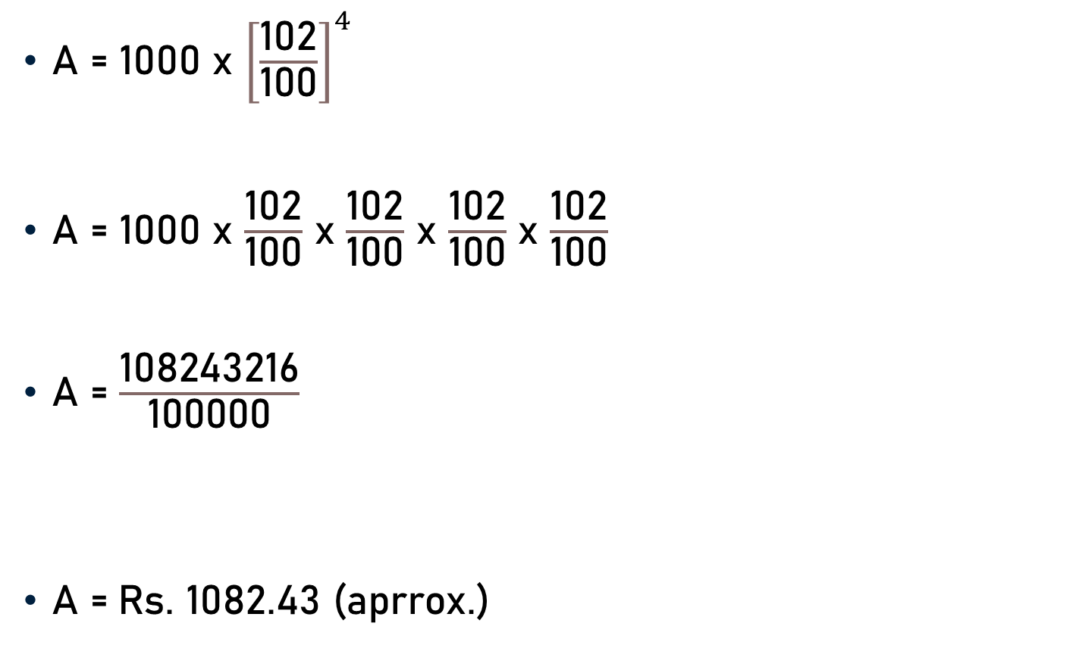
Problem 5
A = 1000 x ${\left[\frac{\text{102}}{\text{100}}\right]}^{4}$
A = 1000 x $\frac{\text{102}}{\text{100}}$ x $\frac{\text{102}}{\text{100}}$ x $\frac{\text{102}}{\text{100}}$ x $\frac{\text{102}}{\text{100}}$
A = $\frac{\text{108243216}}{\text{100}\text{000}}$
A =$\text{Rs}\text{. 1082.43 }\text{(}\text{aprrox}\text{.)}$

Slide 16
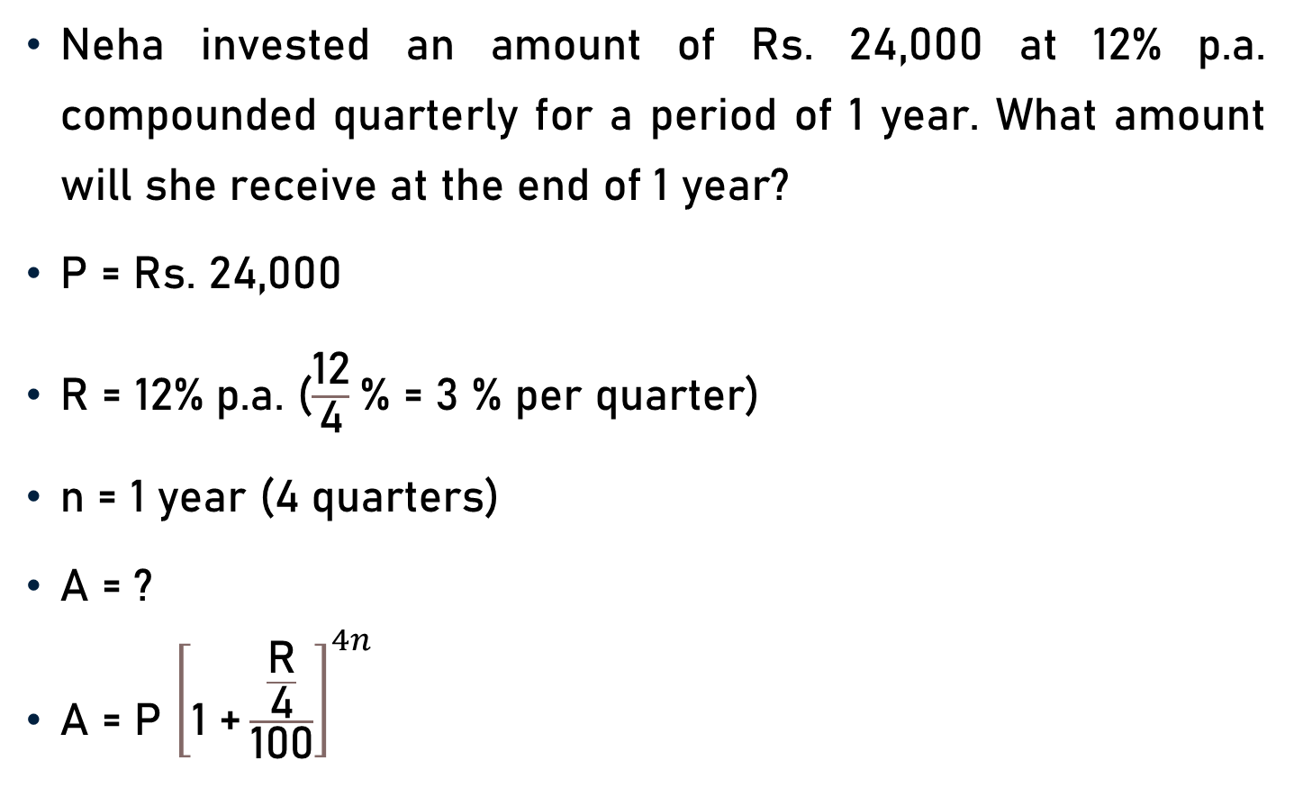
Problem 6
Neha invested an amount of Rs. 24,000 at 12% p.a. compounded quarterly for a period of 1 year. What amount will she receive at the end of 1 year?
P = Rs. 24,000
R = 12% p.a. ($\frac{\text{12}}{\text{4}}$% = 3 % per quarter)
n = 1 year (4 quarters)
A = ?
A = P ${\left[\text{1 +}\frac{\frac{\text{R}}{\text{4}}}{\text{100}}\right]}^{4n}$

Slide 17
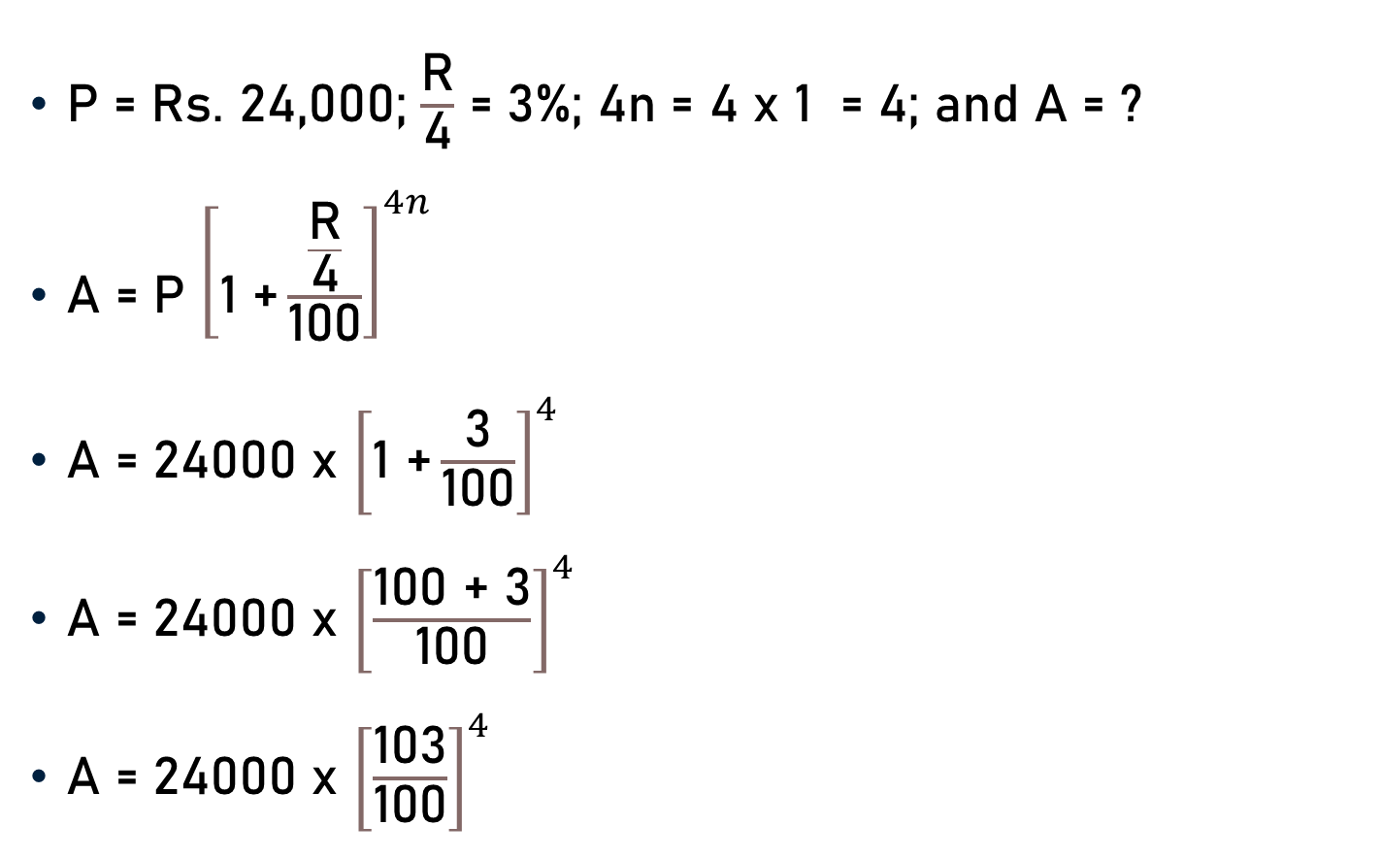
Problem 6
P = Rs. 24,000; $\frac{\text{R}}{\text{4}}$ = 3%; 4n = 4 x 1 = 4; and A = ?
A = P ${\left[\text{1 +}\frac{\frac{\text{R}}{\text{4}}}{\text{100}}\right]}^{4n}$
A = 24000 x ${\left[\text{1 +}\frac{\text{3}}{\text{100}}\right]}^{4}$
A = 24000 x ${\left[\frac{\text{1}\text{00}\text{ +}\text{ 3}}{\text{100}}\right]}^{4}$
A = 24000 x ${\left[\frac{\text{10}\text{3}}{\text{100}}\right]}^{4}$

Slide 18
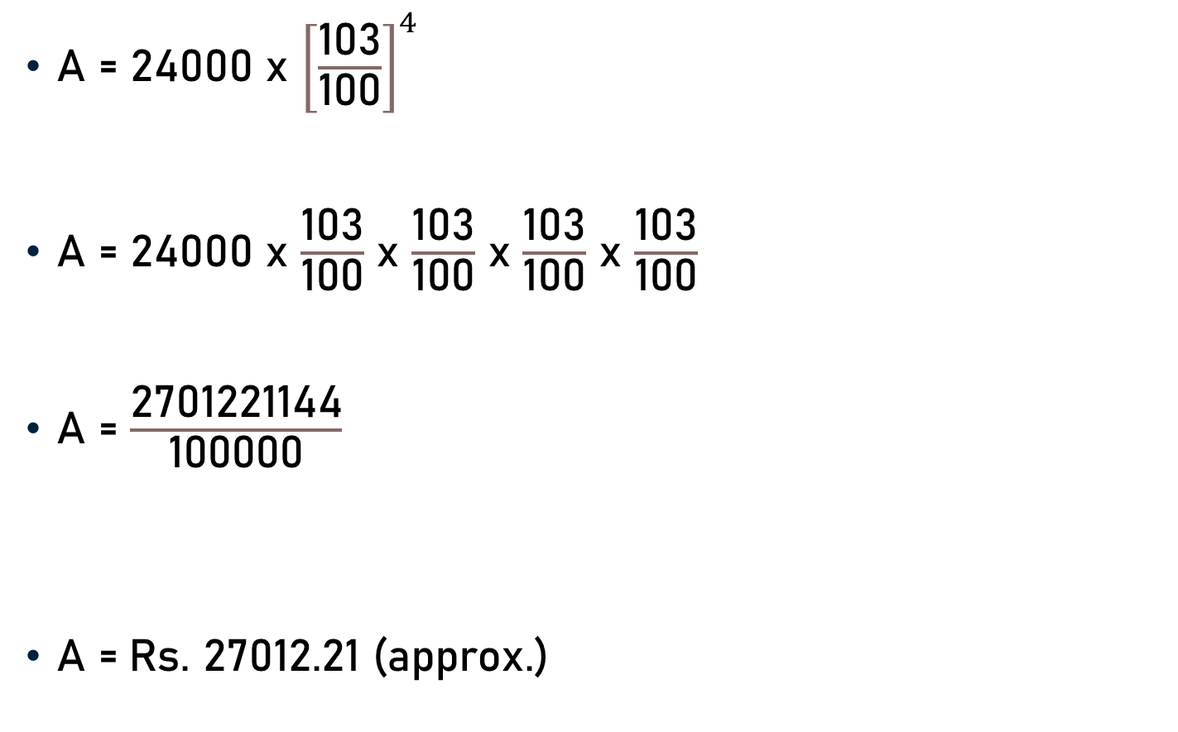
Problem 6
A = 24000 x ${\left[\frac{\text{10}\text{3}}{\text{100}}\right]}^{4}$
A = 24000 x $\frac{\text{10}\text{3}}{\text{100}}$ x $\frac{\text{10}\text{3}}{\text{100}}$ x $\frac{\text{10}\text{3}}{\text{100}}$ x $\frac{\text{10}\text{3}}{\text{100}}$
A = $\frac{\text{2701221144}}{\text{100}\text{000}}$
A =$\text{Rs}\text{. 27012.21 (}\text{approx}\text{.)}$

Slide 19
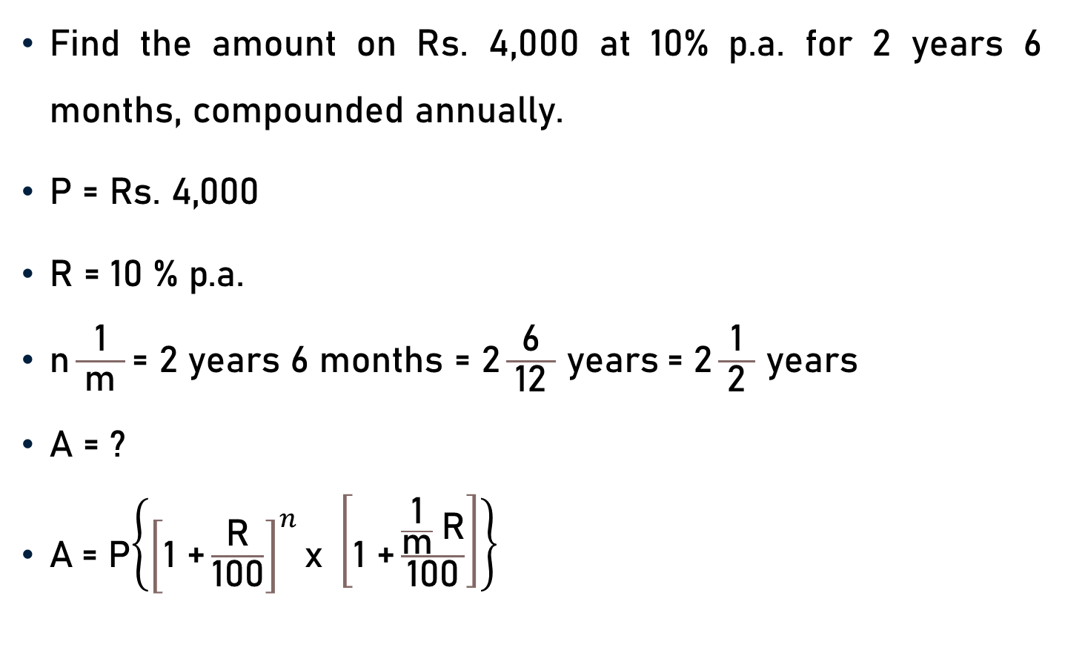
Problem 7
Find the amount on Rs. 4,000 at 10% p.a. for 2 years 6 months, compounded annually.
$\text{P}\text{ = }\text{Rs}\text{. 4,000 }$
$\text{R}\text{ = 10 \% }\text{p}\text{.}\text{a}\text{. }$
$\text{n}\frac{\text{1}}{ \text{m} }\text{=} \text{2 }\text{years}\text{ 6 }\text{months} \text{=}\text{ 2}\frac{\text{6}}{ \text{12 }}$ $\text{years}$= $\text{2}\frac{\text{1}}{ \text{2} }$ $\text{y}\text{ear}\text{s}$
$\text{A}\text{ = ?}$
$\text{A}$= P$\left\{{\left[\text{1 +}\frac{\text{R}}{\text{100}}\right]}^{n}\text{x} \left[\text{1 +}\frac{\frac{\text{1}}{\text{m}} \text{R}}{\text{100}}\right]\right\}$
2

Slide 20
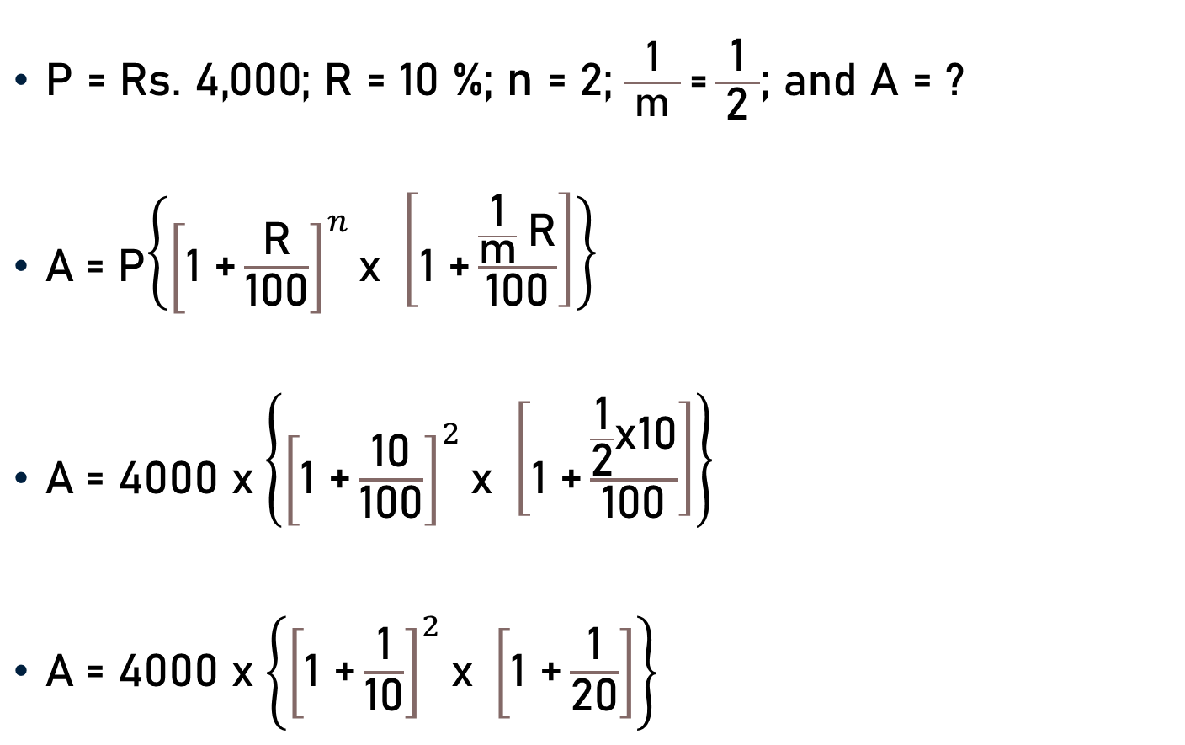
Problem 7
$\text{P}\text{ = }\text{Rs}\text{. 4,000; }\text{R}\text{ = 10 \%; }\text{n} \text{=}$ $\text{2}\text{;}$ $\frac{\text{1}}{ \text{m} }\text{=}\frac{\text{1}}{ \text{2 }}$; and $\text{A}\text{ = ?}$
$\text{A}$= P$\left\{{\left[\text{1 +}\frac{\text{R}}{\text{100}}\right]}^{n}\text{x} \left[\text{1 +}\frac{\frac{\text{1}}{\text{m}} \text{R}}{\text{100}}\right]\right\}$
$\text{A}$= 4000 x$\left\{{\left[\text{1 +}\frac{\text{10}}{\text{100}}\right]}^{2}\text{x} \left[\text{1 +}\frac{\frac{\text{1}}{\text{2}}\text{x}\text{10}}{\text{100}}\right]\right\}$
$\text{A}$= 4000 x$\left\{{\left[\text{1 +}\frac{\text{1}}{\text{10}}\right]}^{2}\text{x} \left[\text{1 +}\frac{\text{1}}{\text{2}\text{0}}\right]\right\}$
5
10
20

Slide 21
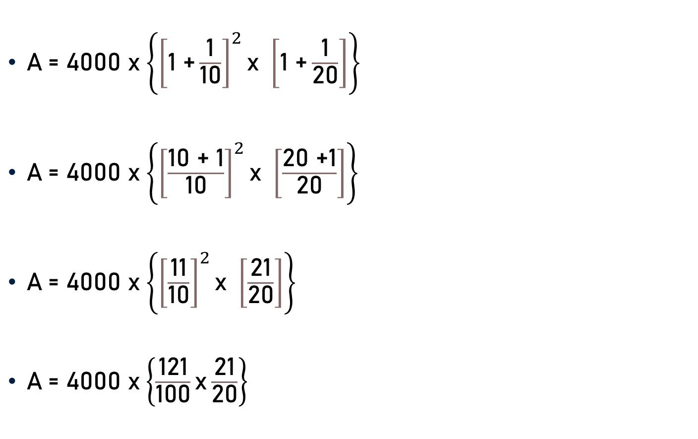
Problem 7
$\text{A}$= 4000 x$\left\{{\left[\text{1 +}\frac{\text{1}}{\text{10}}\right]}^{2}\text{x} \left[\text{1 +}\frac{\text{1}}{\text{2}\text{0}}\right]\right\}$
$\text{A}$= 4000 x$\left\{{\left[\frac{\text{1}\text{0}\text{ +}\text{ 1}}{\text{10}}\right]}^{2}\text{x} \left[\frac{\text{20}\text{ +}\text{1}}{\text{2}\text{0}}\right]\right\}$
$\text{A}$= 4000 x$\left\{{\left[\frac{\text{11}}{\text{10}}\right]}^{2}\text{x} \left[\frac{\text{21}}{\text{20}}\right]\right\}$
$\text{A}$= 4000 x$\left\{\frac{\text{1}\text{2}\text{1}}{\text{1}\text{0}\text{0}}\text{x}\frac{\text{21}}{\text{20}}\right\}$

Slide 22

Problem 7
$\text{A}$= 4000 x$\left\{\frac{\text{1}\text{2}\text{1}}{\text{1}\text{0}\text{0}}\text{x}\frac{\text{21}}{\text{20}}\right\}$
$\text{A}$= 4000 x$\left\{\frac{\text{2541}}{\text{20}\text{0}\text{0}}\right\}$
$\text{A}$= 4000 x$\left\{\text{1}\text{.}\text{2705}\right\}$
$\text{A}$= Rs. 5,082
1.2705

Slide 23
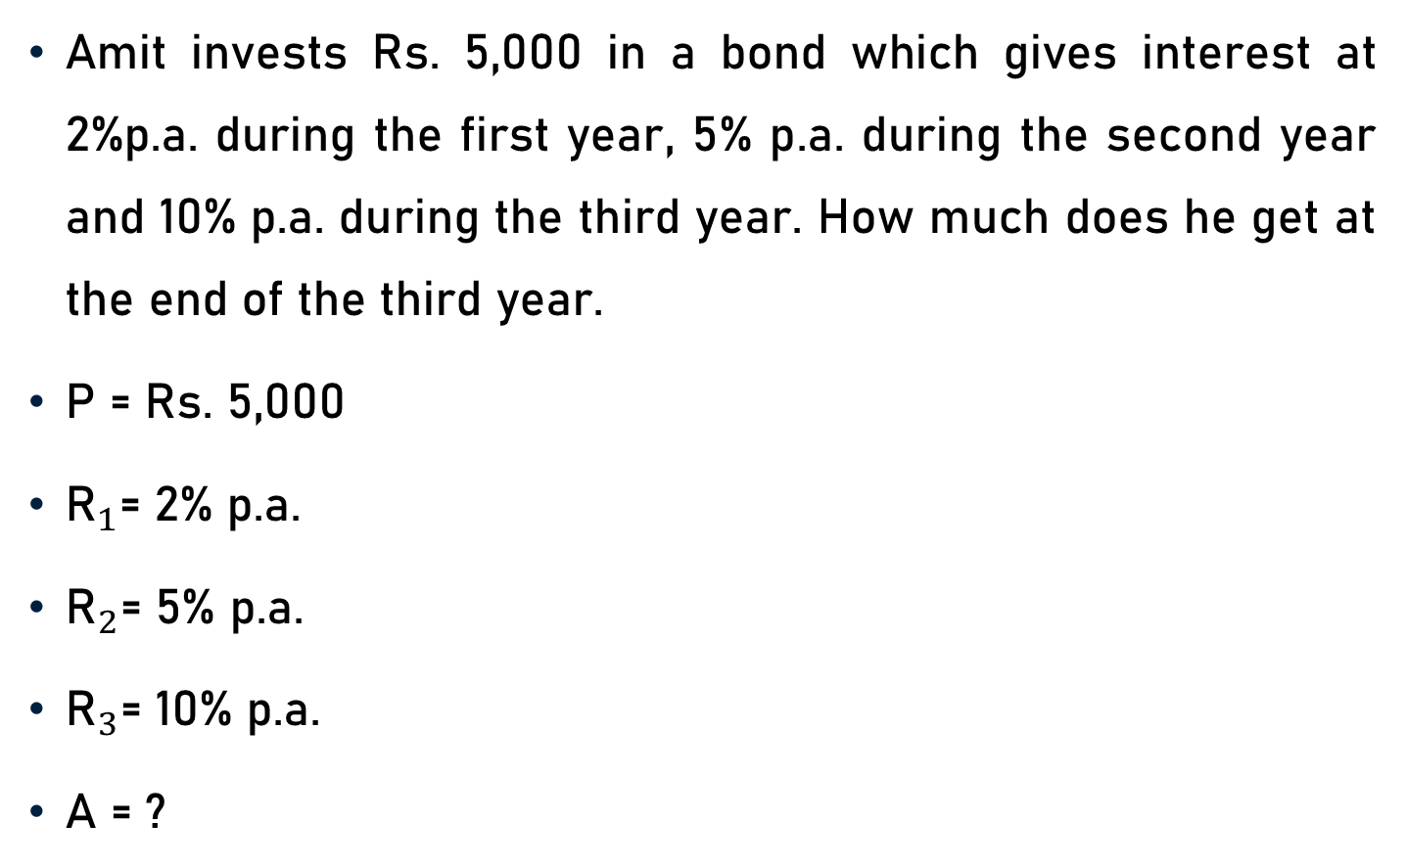
Problem 8
Amit invests Rs. 5,000 in a bond which gives interest at 2%p.a. during the first year, 5% p.a. during the second year and 10% p.a. during the third year. How much does he get at the end of the third year.
P = Rs. 5,000
${\text{R}}_{1}$= 2% p.a.
${\text{R}}_{2}$= 5% p.a.
${\text{R}}_{3}$= 10% p.a.
A = ?

Slide 24
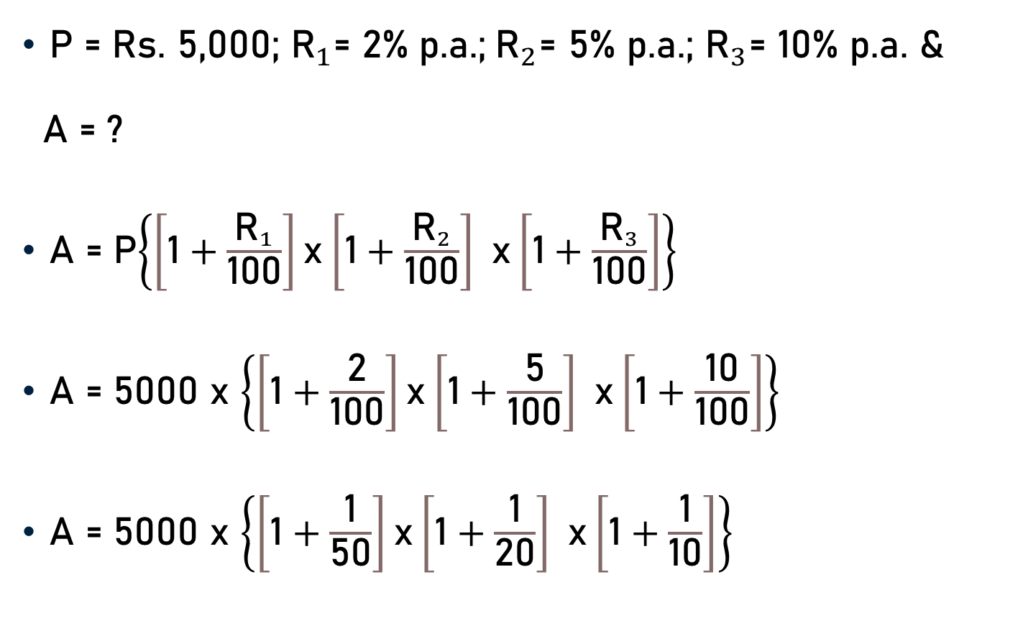
Problem 8
P = Rs. 5,000; ${\text{R}}_{1}$= 2% p.a.;${\text{R}}_{2}$= 5% p.a.; ${\text{R}}_{3}$= 10% p.a. &
A = ?
A = P$\left\{\left[\text{1}+\frac{{\text{R}}_{1}}{\text{100}}\right]\text{x}\left[\text{1}+\frac{{\text{R}}_{2}}{\text{100}}\right] \text{x}\left[\text{1}+\frac{{\text{R}}_{3}}{\text{100}}\right]\right\}$
A = 5000 x $\left\{\left[\text{1}+\frac{\text{2}}{\text{100}}\right]\text{x}\left[\text{1}+\frac{\text{5}}{\text{100}}\right] \text{x}\left[\text{1}+\frac{\text{10}}{\text{100}}\right]\right\}$
A = 5000 x $\left\{\left[\text{1}+\frac{\text{1}}{\text{5}\text{0}}\right]\text{x}\left[\text{1}+\frac{\text{1}}{\text{2}\text{0}}\right] \text{x}\left[\text{1}+\frac{\text{1}}{\text{10}}\right]\right\}$
50
20
10

Slide 25
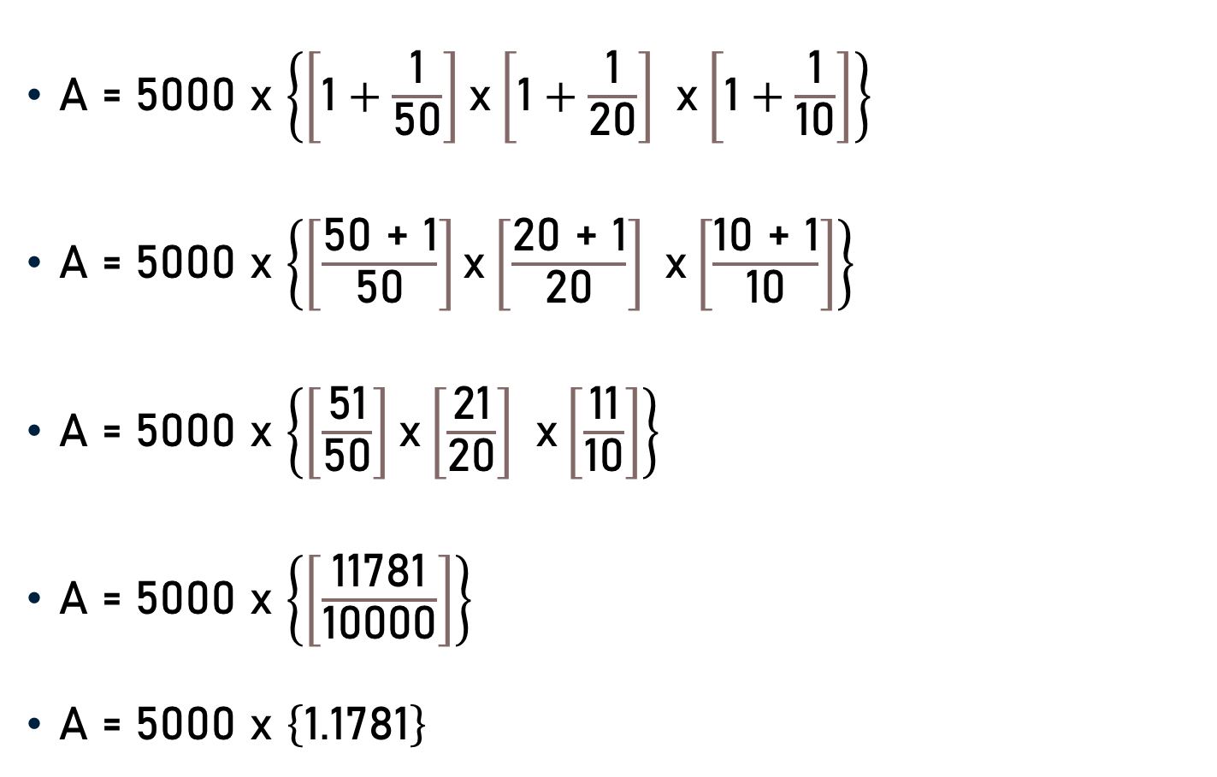
Problem 8
A = 5000 x $\left\{\left[\text{1}+\frac{\text{1}}{\text{5}\text{0}}\right]\text{x}\left[\text{1}+\frac{\text{1}}{\text{2}\text{0}}\right] \text{x}\left[\text{1}+\frac{\text{1}}{\text{10}}\right]\right\}$
A = 5000 x $\left\{\left[\frac{\text{50 + }\text{1}}{\text{50}}\right]\text{x}\left[\frac{\text{20 + }\text{1}}{\text{20}}\right] \text{x}\left[\frac{\text{1}\text{0 + }\text{1}}{\text{10}}\right]\right\}$
A = 5000 x $\left\{\left[\frac{\text{51}}{\text{50}}\right]\text{x}\left[\frac{\text{21}}{\text{20}}\right] \text{x}\left[\frac{\text{11}}{\text{10}}\right]\right\}$
A = 5000 x $\left\{\left[\frac{\text{11781}}{\text{1000}\text{0}}\right]\right\}$
A = 5000 x $\left\{\text{1.1781}\right\}$

Slide 26

Problem 8
A = 5000 x $\left\{\text{1.1781}\right\}$
A = Rs. 5890.50

Slide 27
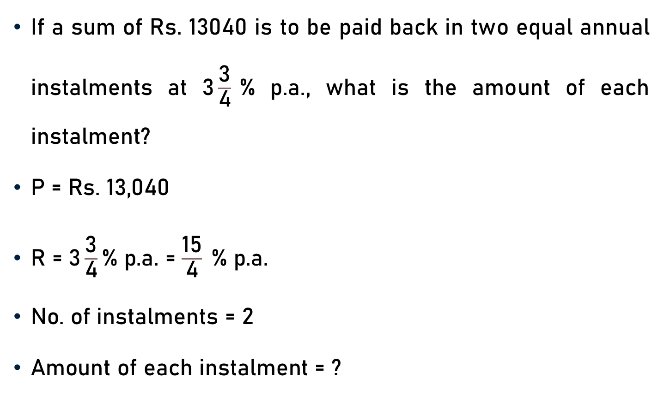
Problem 9
If a sum of Rs. 13040 is to be paid back in two equal annual instalments at 3$\frac{\text{3}}{\text{4}}$% p.a., what is the amount of each instalment?
$\text{P}\text{ = }\text{Rs}\text{. 13,040 }$
$\text{R}\text{ = 3}\frac{\text{3}}{\text{4}}\text{\% }\text{p}\text{.}\text{a}\text{. }$= $\frac{\text{15}}{\text{4}} \text{\% }\text{p}\text{.}\text{a}\text{. }$
$\text{No}\text{. }\text{of} \text{instalments}\text{ =}$ 2
$\text{Amount} \text{of} \text{each} \text{instalment}\text{ = ?}$

Slide 28
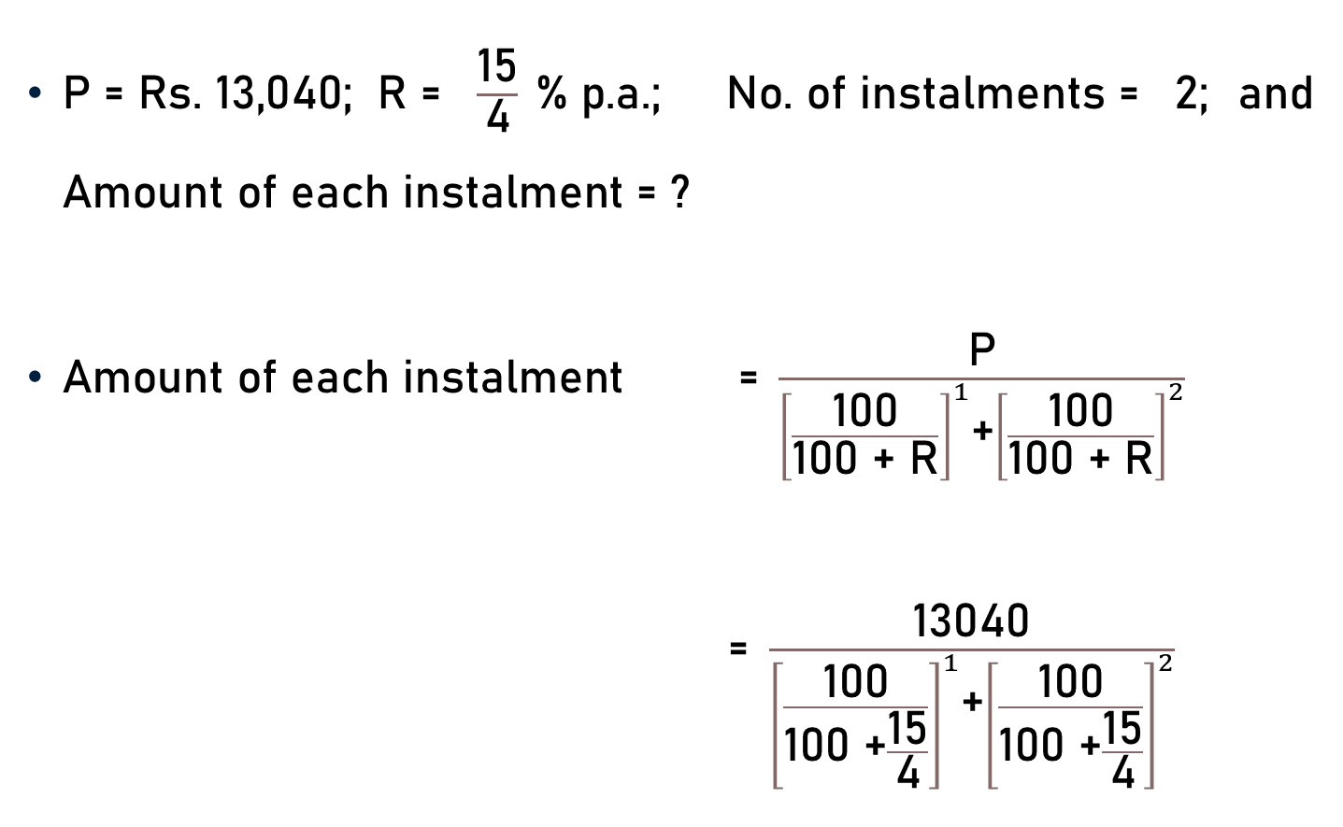
Problem 9
$\text{P}\text{ = }\text{Rs}\text{. 13,040; }\text{R}\text{ =}$ $\frac{\text{15}}{\text{4}} \text{\% }\text{p}\text{.}\text{a}\text{.; }\text{No}\text{. }\text{of} \text{instalments}\text{ =}$ 2; and $\text{Amount} \text{of} \text{each} \text{instalment}\text{ = ?}$
$\text{Amount} \text{of} \text{each} \text{instalment}\text{ = }\frac{\text{P}}{{\left[\frac{\text{100}}{\text{100 + }\text{R}}\right]}^{1}\text{+}{\left[\frac{\text{100}}{\text{100 + }\text{R}}\right]}^{2}}$
$\text{= }\frac{\text{13040}}{{\left[\frac{\text{100}}{\text{100 +}\frac{\text{15}}{\text{4}}}\right]}^{1}\text{+}{\left[\frac{\text{100}}{\text{100 +}\frac{\text{15}}{\text{4}}}\right]}^{2}}$

Slide 29
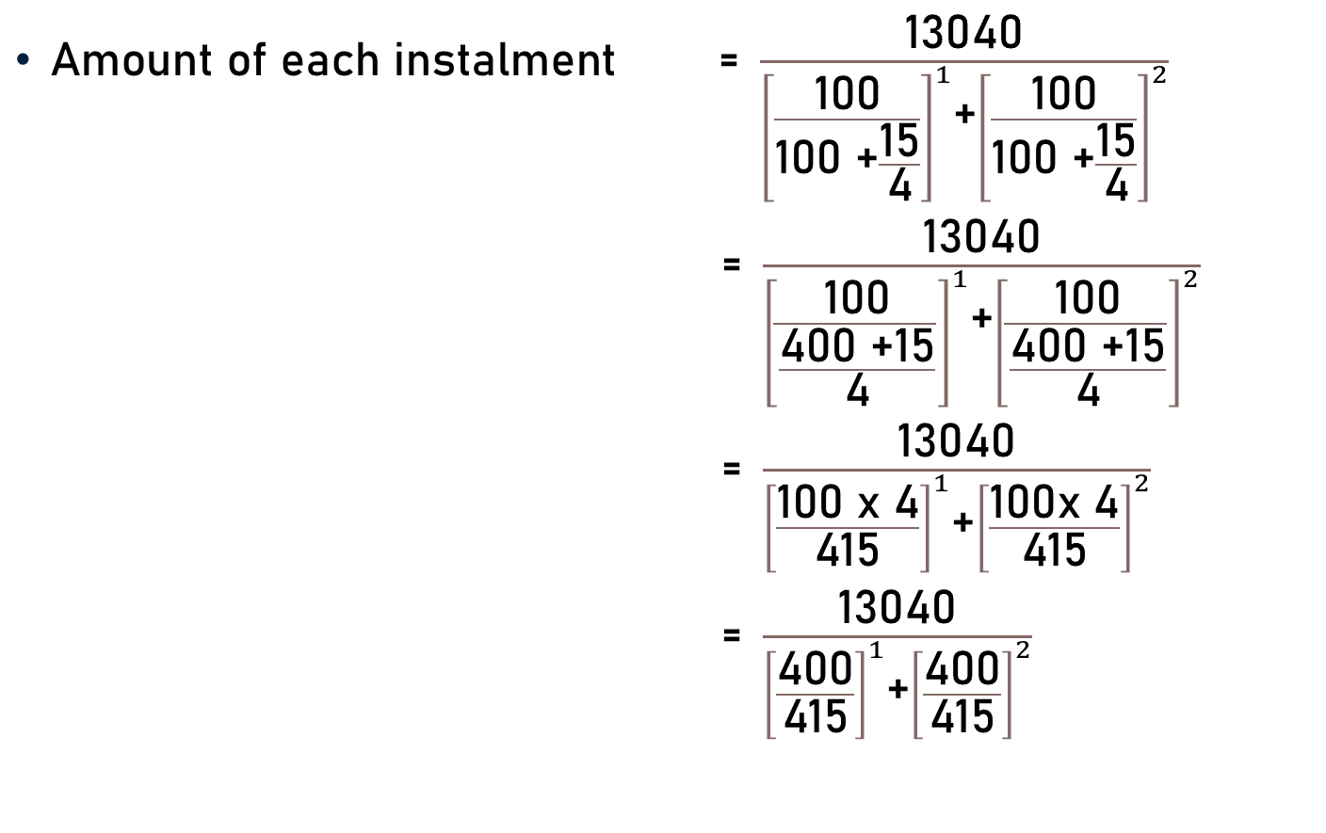
Problem 9
$\text{Amount} \text{of} \text{each} \text{instalment}\text{ = }\frac{\text{13040}}{{\left[\frac{\text{100}}{\text{100 +}\frac{\text{15}}{\text{4}}}\right]}^{1}\text{+}{\left[\frac{\text{100}}{\text{100 +}\frac{\text{15}}{\text{4}}}\right]}^{2}}$
  $\text{= }\frac{\text{13040}}{{\left[\frac{\text{100}}{\frac{\text{4}\text{00 +15}}{\text{4}}}\right]}^{1}\text{+}{\left[\frac{\text{100}}{\frac{\text{4}\text{00 +15}}{\text{4}}}\right]}^{2}}$
  $\text{= }\frac{\text{13040}}{{\left[\frac{\text{1}\text{00} \text{x}\text{ 4}}{\text{415}}\right]}^{1}\text{+}{\left[\frac{\text{100}\text{x}\text{ 4}}{\text{415}}\right]}^{2}}$
  $\text{= }\frac{\text{13040}}{{\left[\frac{\text{4}\text{00}}{\text{415}}\right]}^{1}\text{+}{\left[\frac{\text{4}\text{00}}{\text{415}}\right]}^{2}}$

Slide 30
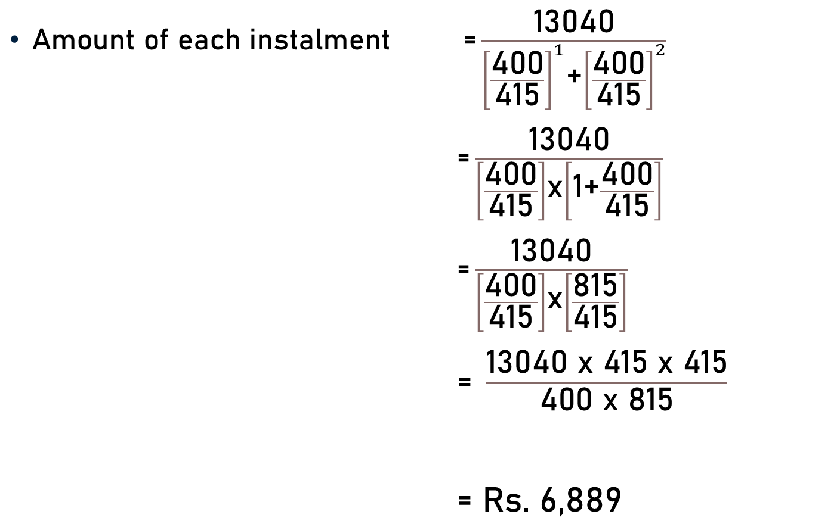
Problem 9
$\text{Amount} \text{of} \text{each} \text{instalment} \text{=}\frac{\text{13040}}{{\left[\frac{\text{4}\text{00}}{\text{415}}\right]}^{1}\text{+}{\left[\frac{\text{4}\text{00}}{\text{415}}\right]}^{2}}$
$\text{=}\frac{\text{13040}}{\left[\frac{\text{400}}{\text{415}}\right]\text{x}\left[\text{1+}\frac{\text{400}}{\text{415}}\right]}$
$\text{=}\frac{\text{13040}}{\left[\frac{\text{400}}{\text{415}}\right]\text{x}\left[\frac{\text{815}}{\text{415}}\right]}$
$\text{=} \frac{\text{13040} \text{x}\text{ 415 }\text{x}\text{ 415}}{\text{4}\text{00 }\text{x}\text{ 815}}$
$\text{=} \text{Rs}\text{. 6,889}$

Slide 31
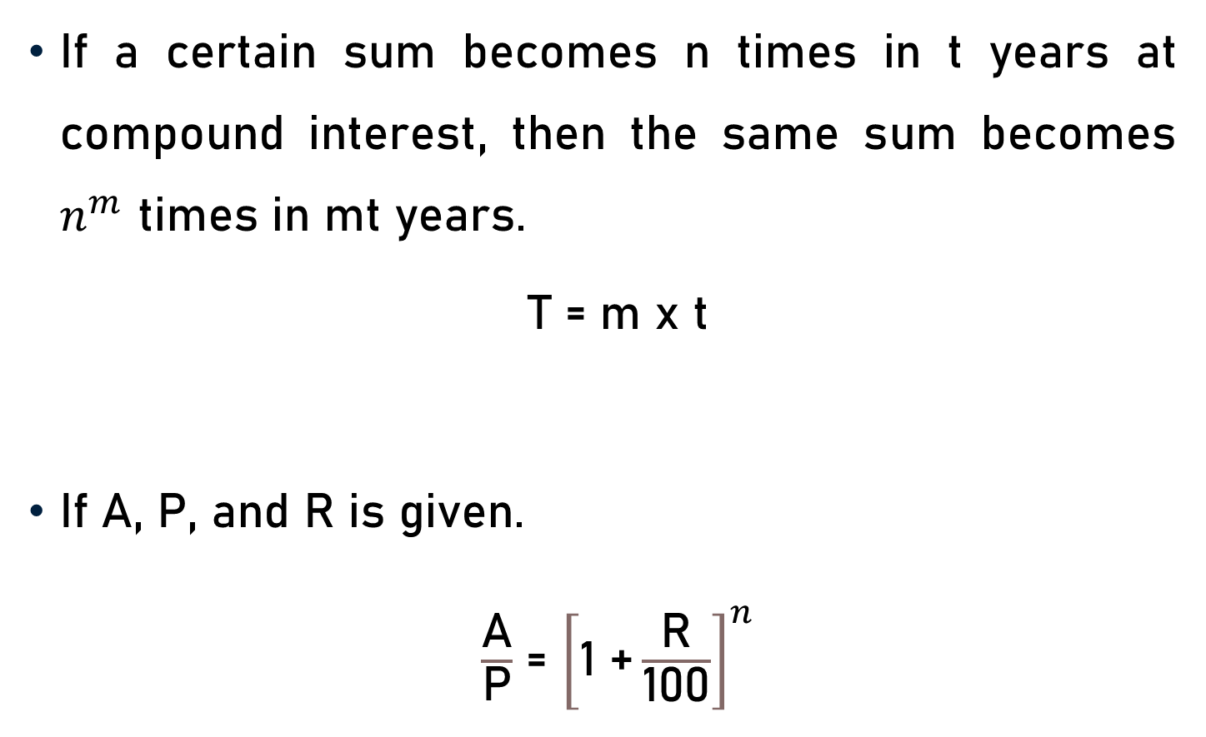
Conclusion
If a certain sum becomes n times in t years at compound interest, then the same sum becomes $n^{m}$ times in mt years.
T = m x t
If A, P, and R is given.
$\frac{\text{A}}{\text{P}}$ = ${\left[\text{1 +}\frac{\text{R}}{\text{100}}\right]}^{n}$

Slide 32
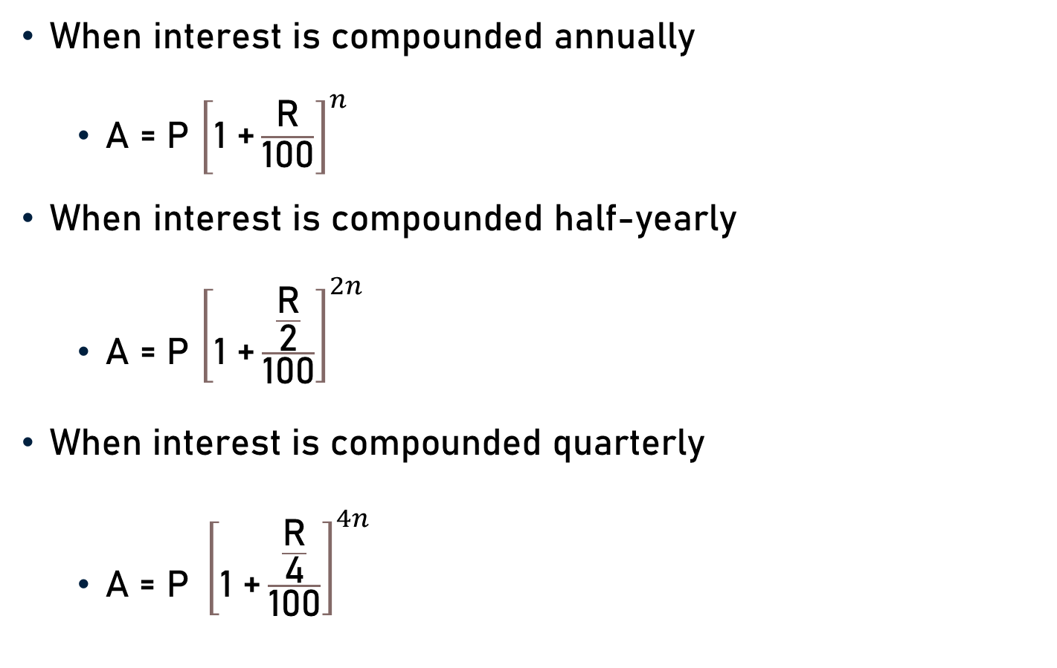
Conclusion
When interest is compounded annually
  A = P ${\left[\text{1 +}\frac{\text{R}}{\text{100}}\right]}^{n}$
When interest is compounded half-yearly
  A = P ${\left[\text{1 +}\frac{\frac{\text{R}}{\text{2}}}{\text{100}}\right]}^{2n}$
$\text{When} \text{interest} \text{is} \text{compounded} \text{q}\text{uarterly}$
  $\text{A}\text{ = }\text{P} {\left[\text{1 +}\frac{\frac{\text{R}}{\text{4}}}{\text{100}}\right]}^{4n}$

Slide 33
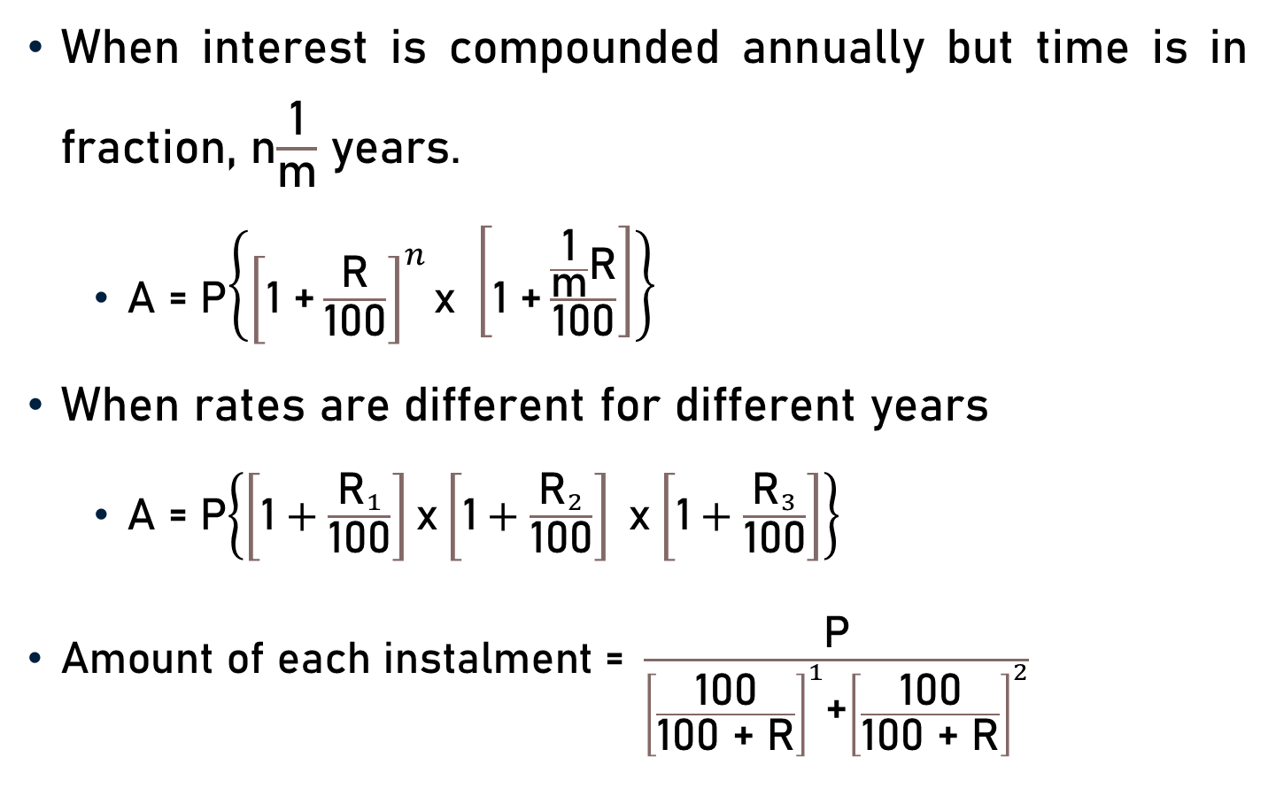
Conclusion
When interest is compounded annually but time is in fraction, n$\frac{\text{1}}{\text{m}}$ years.
  A = P$\left\{{\left[\text{1 +}\frac{\text{R}}{\text{100}}\right]}^{n}\text{x} \left[\text{1 +}\frac{\frac{\text{1}}{\text{m}}\text{R}}{\text{100}}\right]\right\}$
When rates are different for different years
  A = P$\left\{\left[\text{1}+\frac{{\text{R}}_{1}}{\text{100}}\right]\text{x}\left[\text{1}+\frac{{\text{R}}_{2}}{\text{100}}\right] \text{x}\left[\text{1}+\frac{{\text{R}}_{3}}{\text{100}}\right]\right\}$
$\text{Amount} \text{of} \text{each} \text{instalment}\text{ = }\frac{\text{P}}{{\left[\frac{\text{100}}{\text{100 + }\text{R}}\right]}^{1}\text{+}{\left[\frac{\text{100}}{\text{100 + }\text{R}}\right]}^{2}}$

Slide 34
Summary
Computation of
  Time
  Amount

